Slide 1

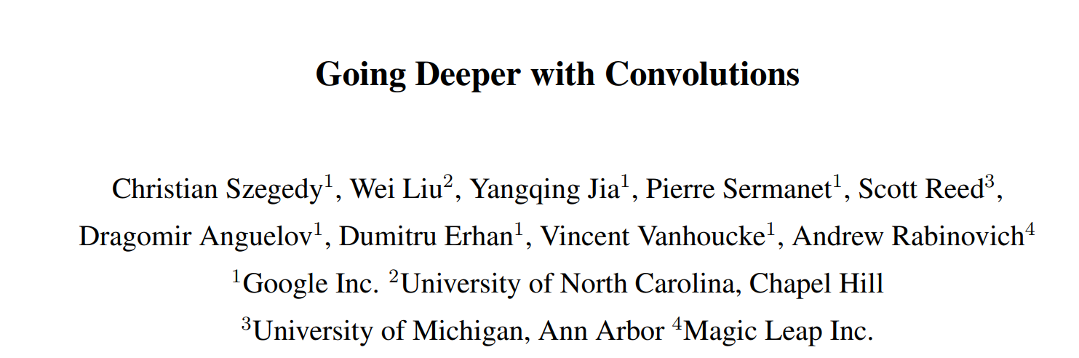

https://ieeexplore.ieee.org/document/7298594
Indra Kumari
UST-KISTI
2022.12.12

Slide 2
Contents
Introduction : GoogLeNet
Background: Inception Model
Conclusion
Experiments: Classification & Detection
Results and Discussion

Slide 3
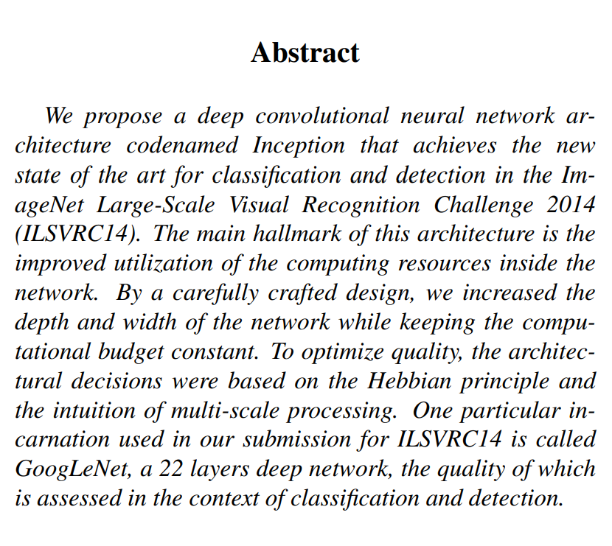
Abstract
What is the main problem addressed?
How to improve performance of deep neural network, while keeping
computational budget constant?
Solution?
GoogLeNet : Deeper networks, with computational efficient
22 layers
GoogLeNet has 22 layers, and its code name is Inception
Efficient “Inception” module – applies 1x1,3x3,5x5 convolution
and 3x3 max pooling (all operations apply padding) on the
previous layer input and concatenates their output
No FC layers
Required only 5M parameters! 12x less parameters than AlexNet
ILSVRC’14 classification winner (6.7% top 5 error)

Slide 4

Introduction
The name Inception, the code name of GoogLeNet ,
originated from the paper Network in Network (NIN),
more precisely, from the line "we need to go deeper"
in the movie “Inception”.
“The deeper you go, the better you learn”.

Slide 5
Introduction
In this paper author focused on the efficient deep neural network
architecture for computer vision codenamed Inception.
Word deep has two different meanings:
First of all, in the sense that we introduce a new level of organization in the form of the “Inception module”.
and also, in the more direct sense of increased network depth.
The model has a flexible structure rather than a rigid fixed structure.
Paper proposed a deep Convolution Neural Network named inception that achieved top results for classification and detection in ILSVRC
2014.

Slide 6
Motivation & High Level Consideration
The simple way to improve the performance of deep neural network is to increase its size.
This means increasing both :
The depth (number of layers in the network)
The width ( number of units in each layer)
Improving the performance of a neural network by increasing the number of layers and nodes.
However, this comes with two major drawbacks:
Increasing the number of parameters also increases the chances of overfitting.
Increasing the network size in such a manner also increases the computational cost.

Slide 7
Motivation & High Level Consideration
How to overcome these problems?
Neural networks perform better when convolutions didn’t alter the dimensions of the
input drastically.
Using smart factorization methods, convolutions can be made more efficient in terms of
computational complexity.
Moreover, they factorize convolutions of filter size nxn to a combination of 1xn and nx1 convolutions.
For example, a 3x3 convolution is equivalent to first performing a 1x3 convolution, and
then performing 3x1 convolutions on its output. 33% cheaper.

Slide 8
Motivation & High Level Consideration
How to overcome these problems?
“Inception module”, the authors showed that a creative structuring of layers can lead to improve performance and be computationally efficient.
The benefits of the architecture are experimentally verified on the ILSVRC 2014
classification and detection challenges.
This paper has really set the stage for some amazing architectures that significantly outperform the current state of the art.

Slide 9
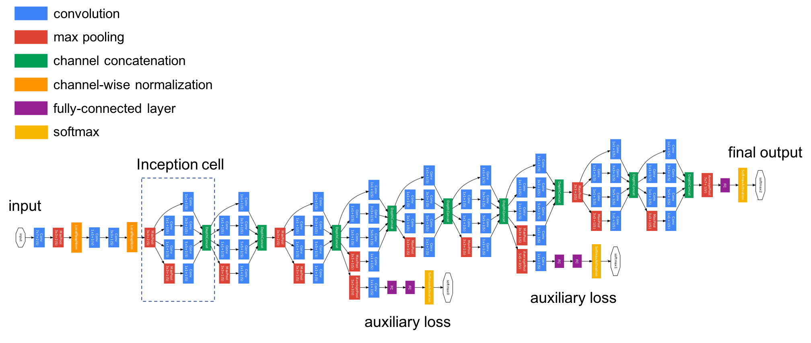
Architectural Details
“Inception module”: Design a good local network topology (network within a network) and then stack
these modules on top of each other.
“GoogLeNet” network with all the bells and whistles.

Slide 10
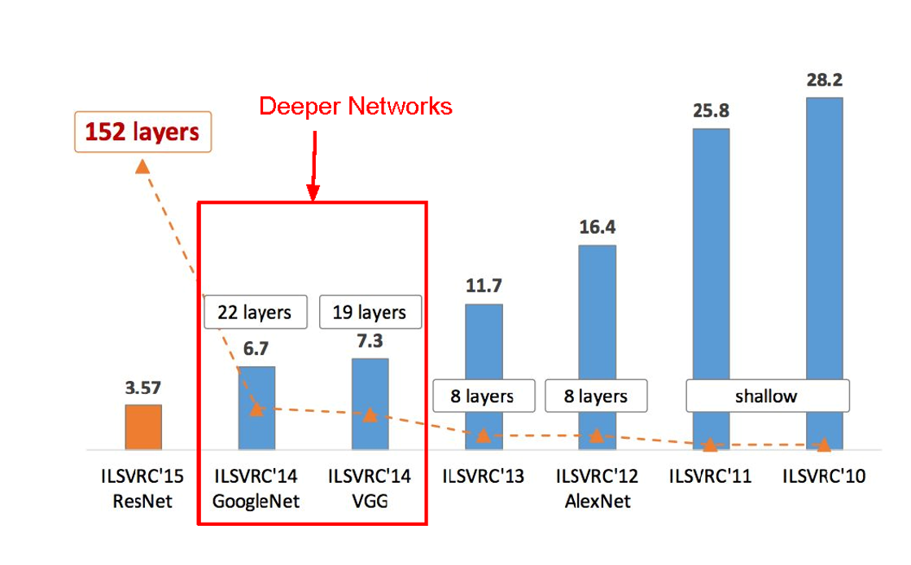
Architectural Details
ImageNet Large Scale Visual Recognition Challenge(ILSVRC) winners

Slide 11
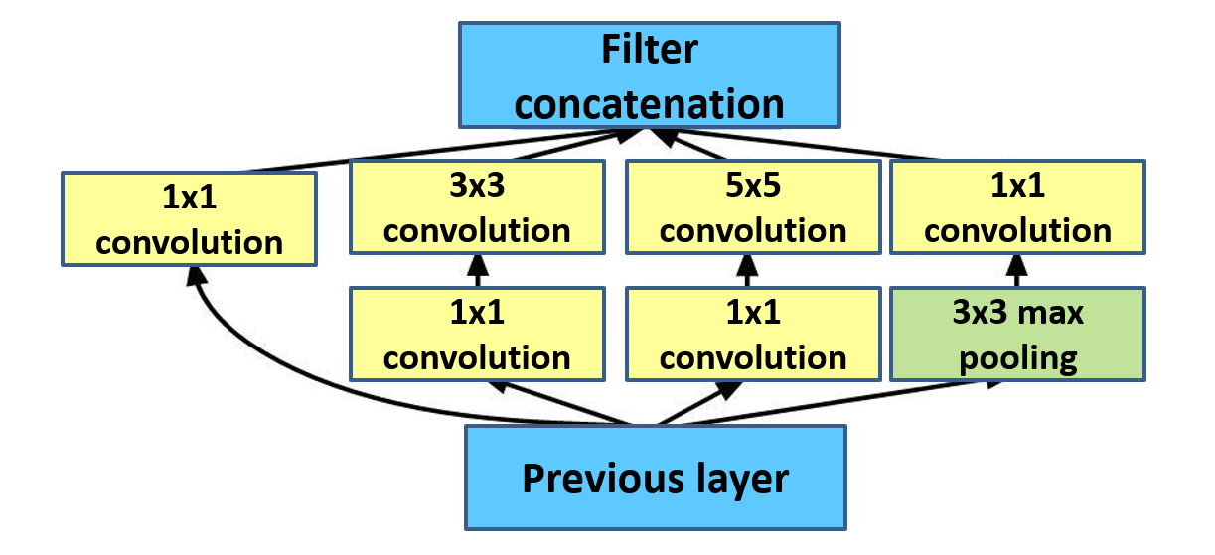
Experiment
GoogLeNet
“Inception module”: design a good local network topology (network within a network) and then stack these modules on top of each other.

Slide 12
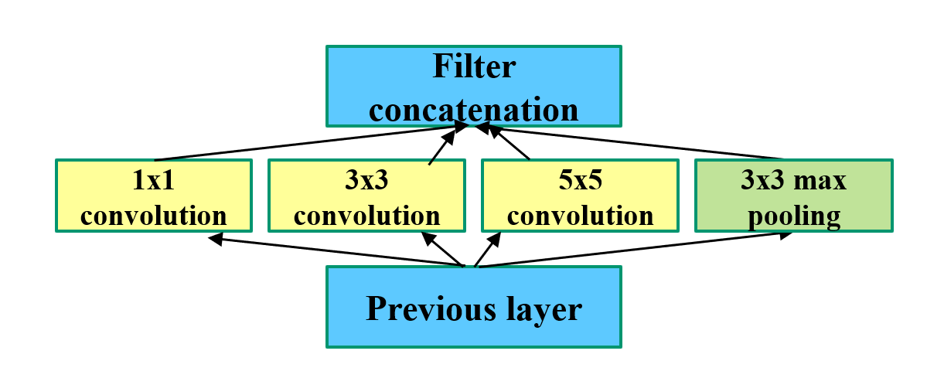
Experiment
GoogLeNet
(a) Inception Model, Naïve version
Apply parallel filter operations on the input :
Multiple receptive field sizes for convolution (1x1, 3x3, 5x5)
Pooling operation (3x3)
Concatenate all filter outputs together depth-wise

Slide 13
Experiment
GoogLeNet
(a) Inception Model, Naïve version
What’s the problem with this? High computational complexity

Slide 14
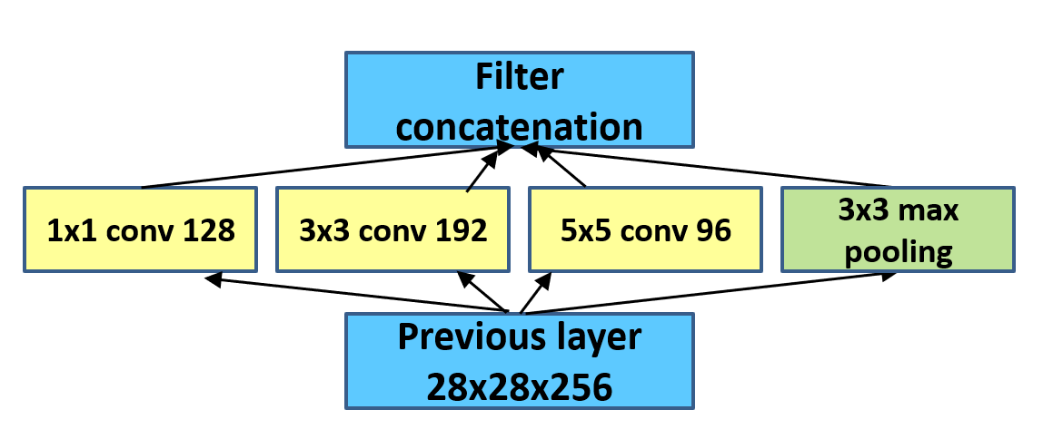
Experiment
“GoogLeNet”
Output volume sizes:
1x1 conv, 128: 28x28x128
3x3 conv, 192: 28x28x192
5x5 conv, 96: 28x28x96
3x3 max pool: 28x28x256
What is output size after filter concatenation?
28x28x(128+192+96+256) = 28x28x672
Example:

Slide 15
Experiment
“GoogLeNet”
Example:
Number of convolution operations:
1x1 conv, 128: 28x28x128x1x1x256
3x3 conv, 192: 28x28x192x3x3x256
5x5 conv, 96: 28x28x96x5x5x256
Total: 854M ops

Slide 16
Experiment
“GoogLeNet”
Very expensive compute!
Pooling layer also preserves feature depth, which means total depth after concatenation can only grow at every layer.

Slide 17
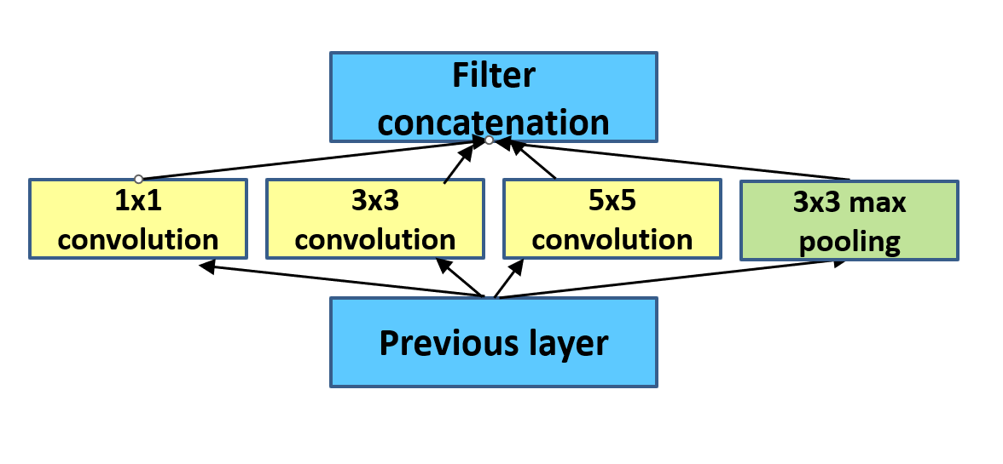
Experiment
“GoogLeNet”
Solution: (b) “Inception module with dimensionality reductions” or
“bottleneck” layers that use 1x1 convolutions to reduce feature depth.

Slide 18
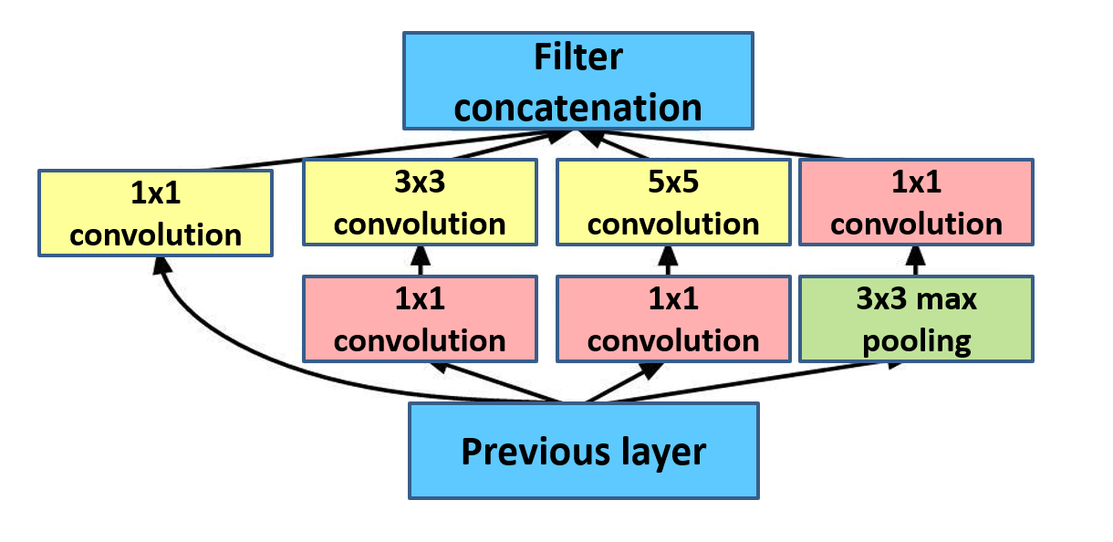
Experiment
“GoogLeNet”
Solution: “bottleneck” layers that use 1x1 convolutions to reduce
feature depth.

Slide 19
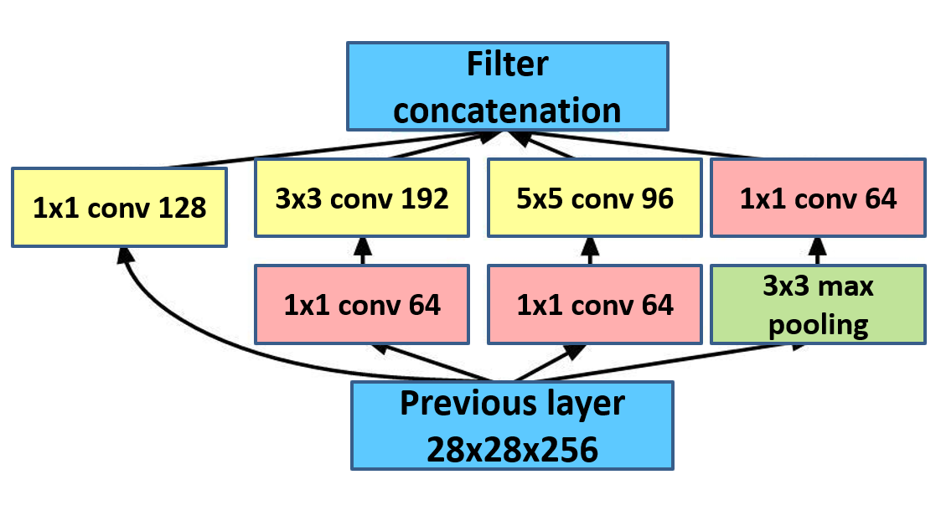
Experiment
“GoogLeNet”
Number of convolution operations: 1x1 conv, 64: 28x28x64x1x1x256 1x1 conv, 64: 28x28x64x1x1x256 1x1 conv, 128: 28x28x128x1x1x256 3x3 conv, 192: 28x28x192x3x3x64 5x5 conv, 96: 28x28x96x5x5x64 1x1 conv, 64: 28x28x64x1x1x256 Total: 353M ops
Bottleneck layer also reduces number of operations from 854M to 353M .
Compared to 854M ops for the
naive version

Slide 20
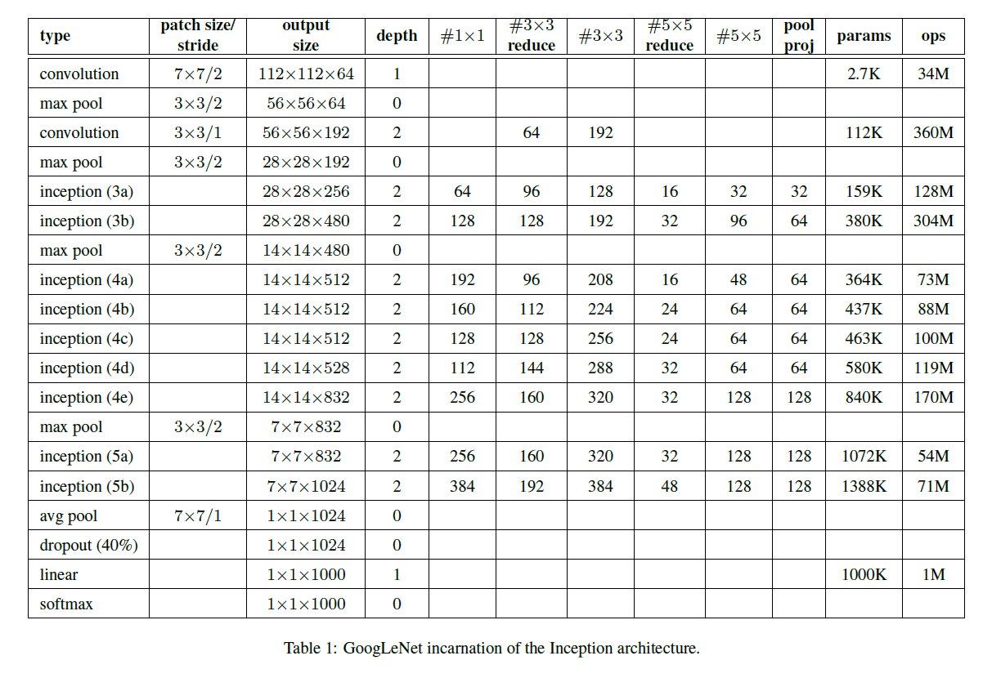
Architectural Details

Slide 21
Architectural Details
Operation
The meaning of the above column is as follows:
1) Type: The type used in the layer
2) patch size/stride: Filter size and stride used in convolution/pooling
3) output size: Size of feature map obtained after applying convolution/pooling/inception module
4) depth: The number of convolution layers.
5) #1x1 : The number of feature maps obtained after 1x1 convolution.
6) Reduced #3x3: The number of feature maps obtained after 1x1 convolution performed before 3x3 convolution
in Inception module.
7) #3x3 : The number of feature maps obtained after 3x3 convolution.
8) Reduced #5x5: The number of feature maps obtained after 1x1 convolution performed before 5x5 convolution
in Inception module.
9) #5x5 : The number of feature maps obtained after 5x5 convolution.
10) pool/proj: The number of feature maps obtained after 1x1 convolution performed after 3x3 map-pooling in the
Inception module.
11) params: The number of free parameters used in the layer.
12) ops: Number of operations.

Slide 22
1. ILSVRC 2014 Classification Challenge setup and Results
ILSVRC 2014 Classification tasks:
The ILSVRC 2014 classification problem involves classifying an image into one of ImageNet’s
1000 categories.
Training data = 1.2 million images
Validation data = 50,000 images
Test data = 100,000 images
The network was independently trained for seven versions of the same GoogLeNet model and
performed an ensemble prediction with them.
No external data used for training.
During the tests, the model aggressive approaches to cropping.

Slide 23
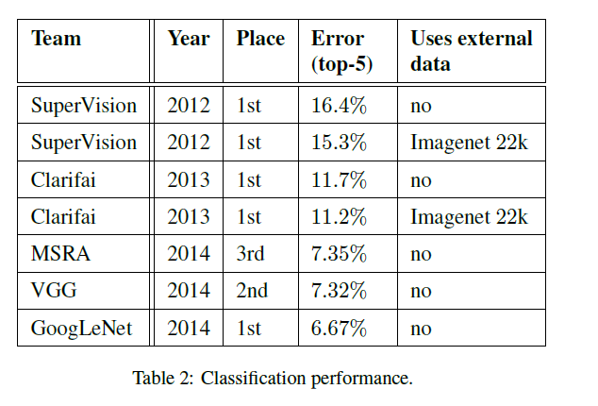
1. ILSVRC 2014 Classification Challenge setup and Results
Experiment
As a result of the final submission to the
competition in both validation and test data
recorded 6.67% in the top 5 error rates,
taking first place.
This is a relative decrease of 56.5% compared to SuperVision in 2012,
Decrease of approximately 40% compared to
Clarifai, which was the best-performing
approach in 2013.
Table 2 shows the results of the top-ranked approaches over the
three-year period from 2012 to 2014.

Slide 24
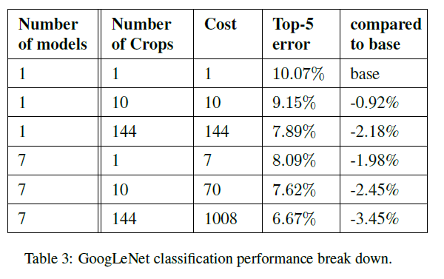
1. ILSVRC 2014 Classification Challenge setup and Results
Experiment
Table 3 above analyzes the results obtained through tests that change the number of models and crops in the prediction process.
When using one model, the model with the lowest
top 1 error rate was selected in the validation data.
Refer only to the results on the validation data to
avoid overfitting to the test data.
Table 3 shows the Comparison of GogLeNet's
classification performance by condition

Slide 25
2. ILSVRC 2014 Detection Challenge setup and Results
ILSVRC 2014 Detection tasks:
Produce bounding boxes around 200 class objects.
A detected object is considered correct if it matches the true value and overlaps more than 50% of the bounding box (using the Jaccard index).
Irrelevant detections are considered false positives and penalized.
Unlike classification problems, each image may or may not contain many objects, and the
objects may be of different sizes.
Performance is measured using mean Average Precision (mAP) .

Slide 26
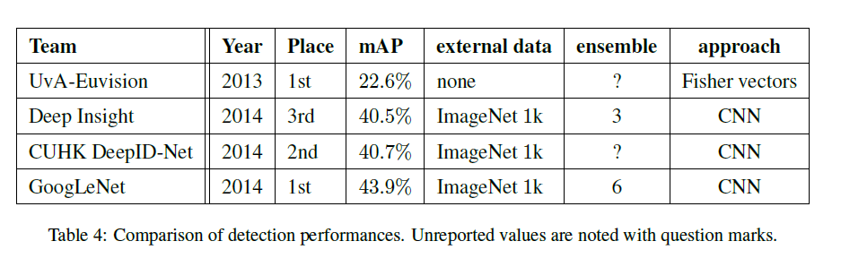
2. ILSVRC 2014 Detection Challenge setup and Results
Experiment
Top-ranked approaches in the detection problem and their
evolution since the initial version.
Compared to the 2013 results, the accuracy has almost
doubled.
Each team's common strategy. Strategy refers to whether
external data is used and whether it is an ensemble or
contextual model.
External data generally refers to ILSVRC 2012 classification
data.
Table 4. Comparison of detection performance
(? means values ​​not mentioned)

Slide 27
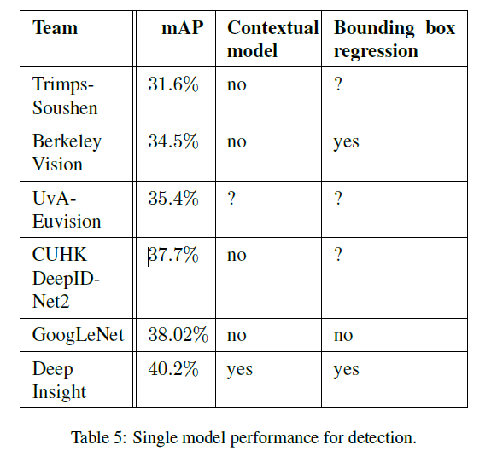
2. ILSVRC 2014 Detection Challenge setup and Results
Experiment
Compares results using only a single model.
The best performing Deep Insight improves by 0.3 points by ensemble of 3 models, while
GoogLeNet achieves much stronger
performance with the ensemble.
Table 5. Comparison of single model performance
in the detection problem.

Slide 28
Result and Discussion
Is the evaluation valid?
GoogLeNet is a 22-layer CNN and was the winner of ILSVRC 2014 with a top 5 error
rate of 6.7%.
To my knowledge, this was one of the first CNN architectures that really strayed from
the general approach of simply stacking Conv and pooling layers on top of each other
in a sequential structure.
The authors of the paper also emphasized that this new model places notable consideration on memory and power usage.
Stacking all of these layers and adding huge numbers of filters has a computational and memory cost, as well as an increased chance of overfitting.

Slide 29
Conclusion
What would be the impact of this paper?
For classification and detection, it is expected that similar quality of the result can be
achieved by much more expensive non-Inception-type networks of similar depth and
width.
Authors’ approach yields solid evidence that moving to sparser architectures is a feasible and useful idea in general.
It significantly improves performance with a small increase in computing cost compared
to shallow and narrow architectures.

Slide 30
Future Work
The main strength of the Inception architecture is considerable improvement in
performance in exchange for a minimal increase in computational cost.
Performance of the Inception models can be matched by more expensive models.
Towards creating sparser and more refined structures in automated ways.
Applying the insights of the Inception architecture to the other domain.

Slide 31

Thank you for your attention !
감사합니다!

